Slide 1
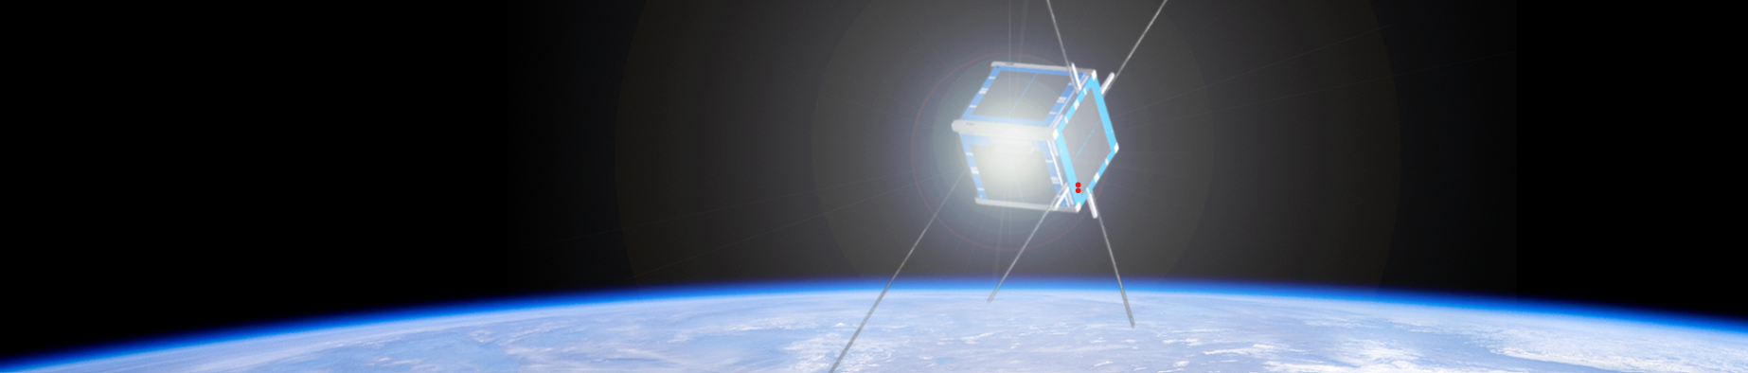




Vacuum Chamber Testing
Gabriela Roig and Dr. Danny Jacobs
School of Earth and Space Exploration
Arizona NASA Space Grant Symposium Consortium
April 23,2022

Slide 2

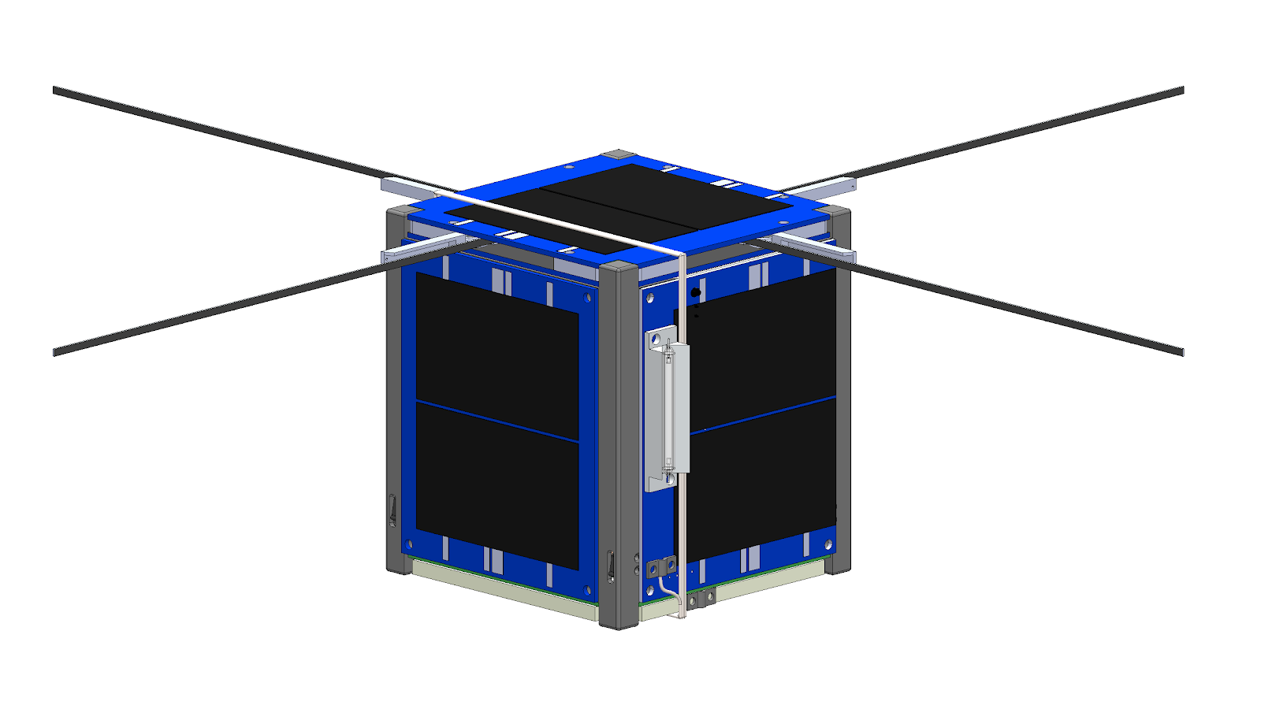
What is LightCube?
Lightcube is 1U CubeSat educational outreach project
will be interactable through easily obtained radio systems
Once communicated with, LightCube will be visible via light flash
Deployable UHF Antenna
Xenon Flash-tubes (2)
Two flashes located on opposite ends
Solar Panels (6)
Gravity Gradient Counterweight
Deployment Inhibit Switches(4)
Gravity Gradient Boom
Fig 1. Vega Space Systems LightCube CAD
Notes:
Educational outreach in the sense that it is easy for the general public to do, ham radio

Slide 3
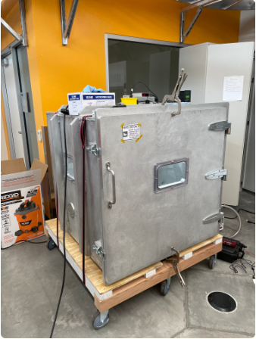
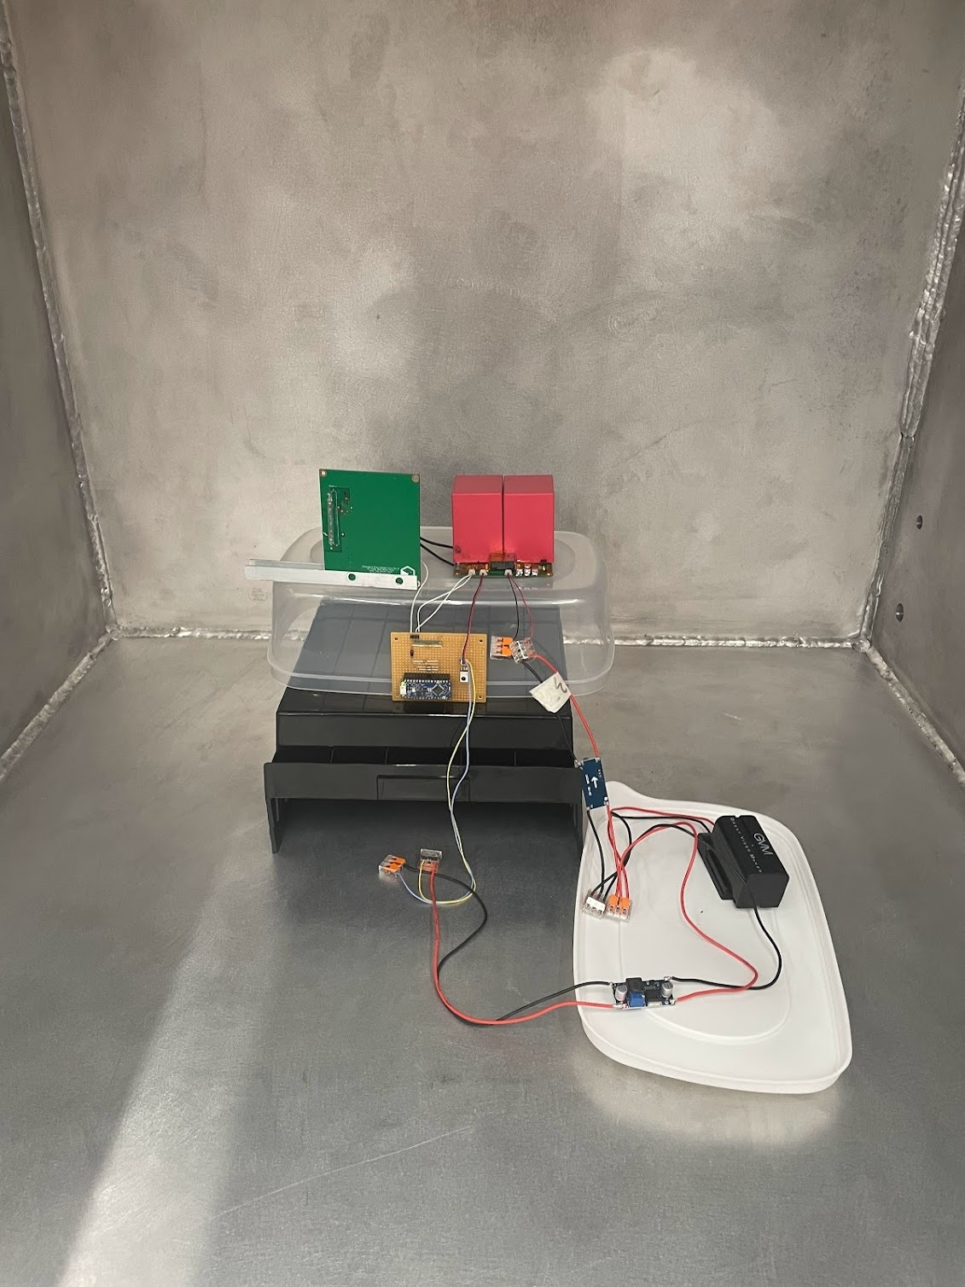
Why is Vacuum Chamber Testing Necessary?
The purpose of Thermal Vacuum Chamber (TVAC) testing is to understand a system’s performance through environmental extremes
Fig 2. II Lab TVAC Chamber
Fig 3. LightCube payload test setup, Photo Credit: Chandler Hutchens
Notes:
II lab has TVAC in order to be more easily accessible to students. 1m^3, with roughing pump and turbo pump. Important to test in order to determine if the system meets its goals and requirements . Basically to validate that the correct system was built and it was built right, so testing is a very important part of the mission life cycle

Slide 4
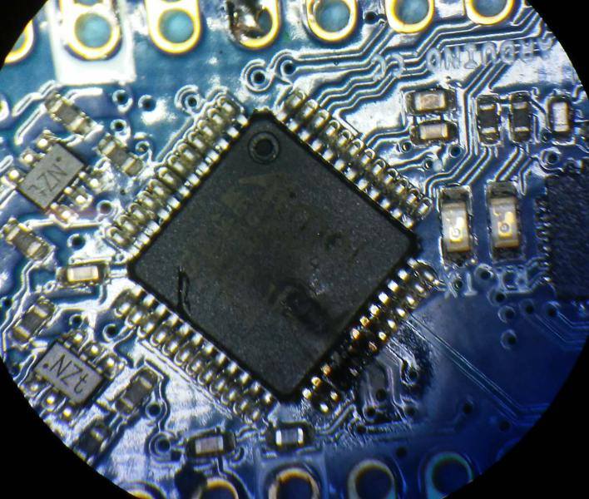
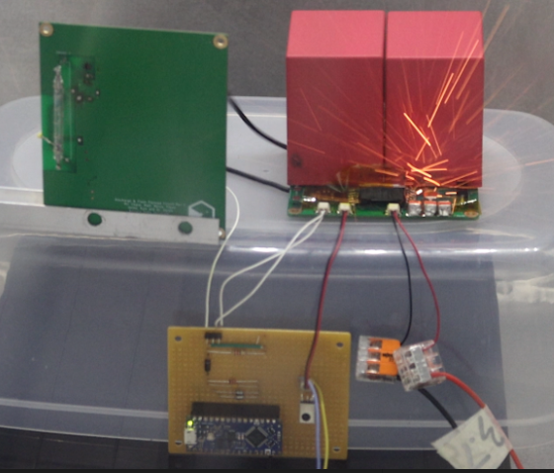
Problem
During testing, arcs damaged the charging circuit Microcontroller Unit (MCU)
This event continued to occur despite preventative measures being taken
Fig 4. Damaged Charging Circuit Arduino MCU
Fig 5. Payload arcing in TVAC
Notes:
760 Torr = 1 atm (pressure we are under from earth’s atmosphere)
Redesign of the payload charging circuit board, creation of a filter circuit to prevent current from running in the wrong direction

Slide 5
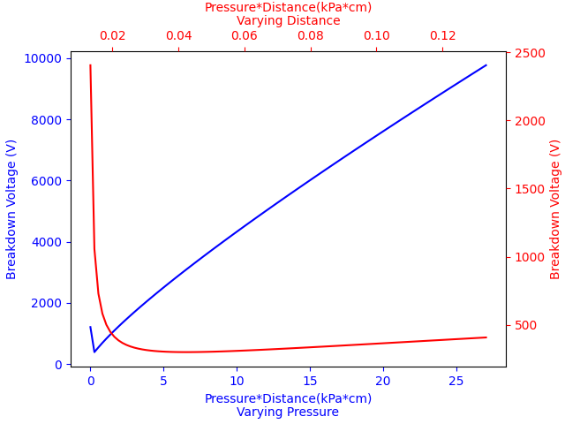
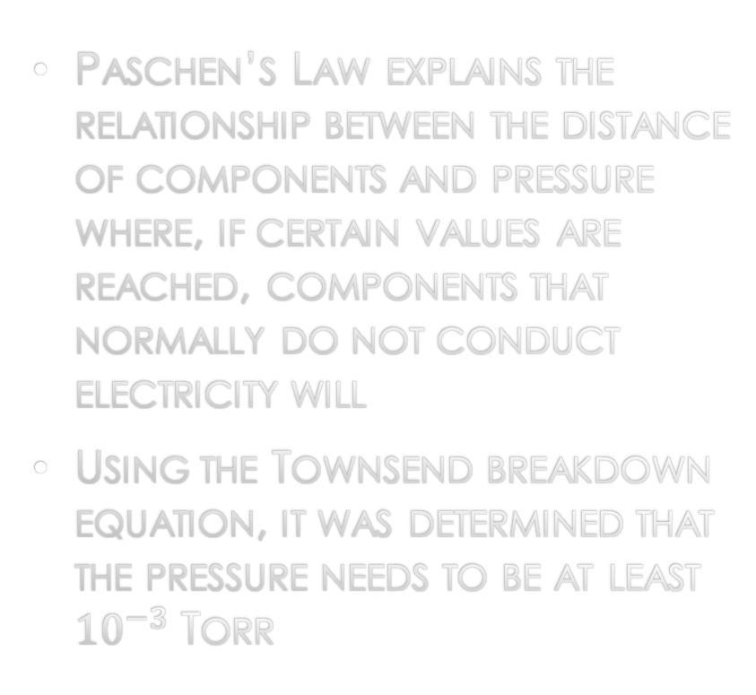
Rediscovering Paschen’s law and the Townsend breakdown equation
Paschen’s Law explains the relationship between the distance of components and pressure where, if certain values are reached, components that normally do not conduct electricity will
Using the Townsend breakdown equation, it was determined that the pressure needs to be at least ${10}^{−3}$ Torr
Arcing Occurred
Arcing occurred
Figure 6: Calculated Paschen’s Curve Graph with varying pressure curve and varying distance curve

Slide 6
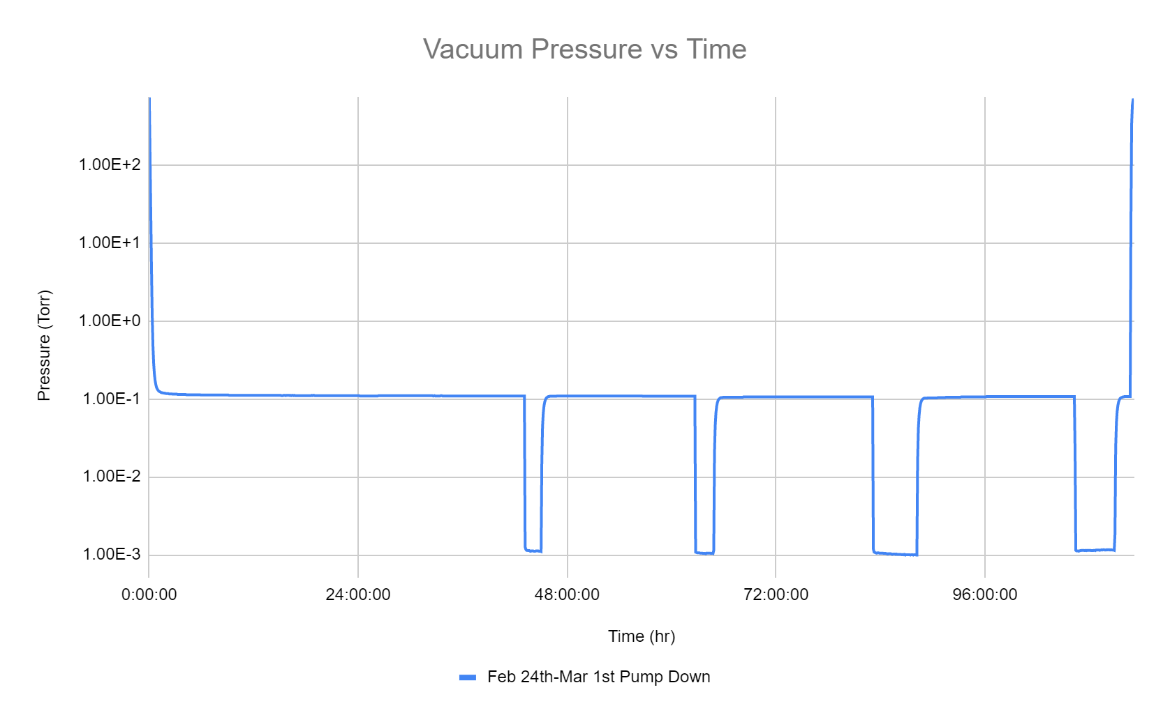
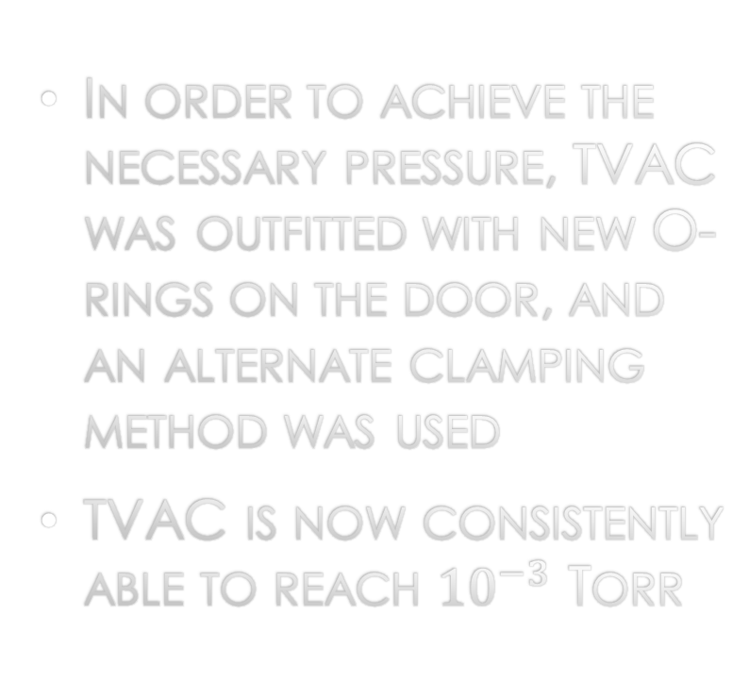
Results
In order to achieve the necessary pressure, TVAC was outfitted with new O-rings on the door, and an alternate clamping method was used
TVAC is now consistently able to reach ${10}^{−3}$ Torr
Fig 7. Pressure versus Time graph of TVAC during multiday testing

Slide 7
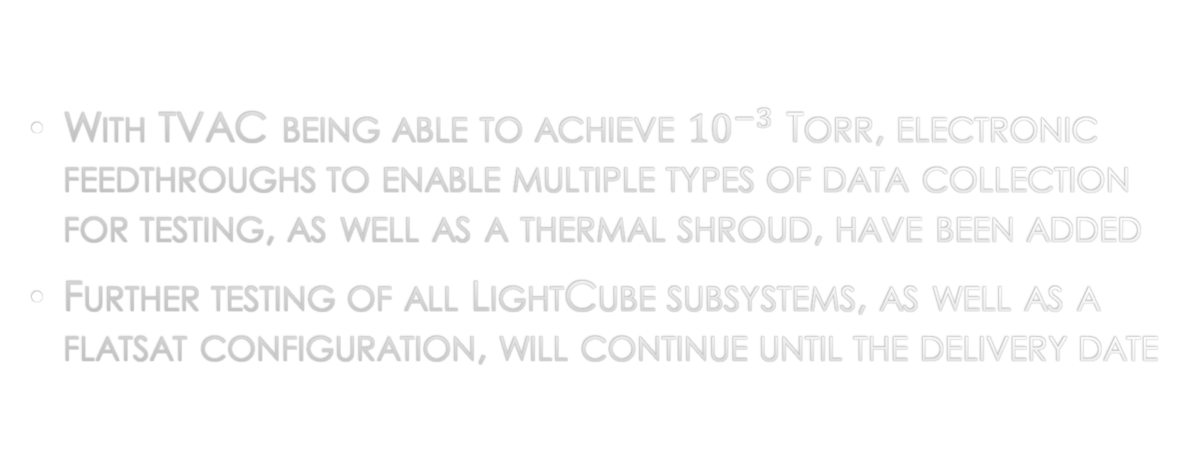
Conclusion
With TVAC being able to achieve ${10}^{−3}$ Torr, electronic feedthroughs to enable multiple types of data collection for testing, as well as a thermal shroud, have been added
Further testing of all LightCube subsystems, as well as a flatsat configuration, will continue until the delivery date

Slide 8
Acknowledgments
I would like to thank Arizona NASA Space Grant Consortium for this wonderful opportunity, my mentor Dr. Danny Jacobs and II Lab Lifeguards: Matthew Adkins, Chandler Hutchens, Christopher McCormick, Ashley Lepham, and Ben Weber for all their help.

Slide 9
Thank you

Slide 10
Sources
Husain, E., and Nema, R. S., “Analysis of paschen curves for air, N2 and SF6 using the Townsend breakdown equation,” IEEE Transactions on Electrical Insulation, vol. EI-17,1982, pp. 350–353.
Lieberman, Michael A.; Lichtenberg, Allan J. (2005). Principles of plasma discharges and materials processing (2nd ed.). Hoboken, N.J.: Wiley-Interscience.

